Slide 1
Machine Learning 2:
Practical Considerations to Design Deep Learning Models in Medical Imaging

Slide 2
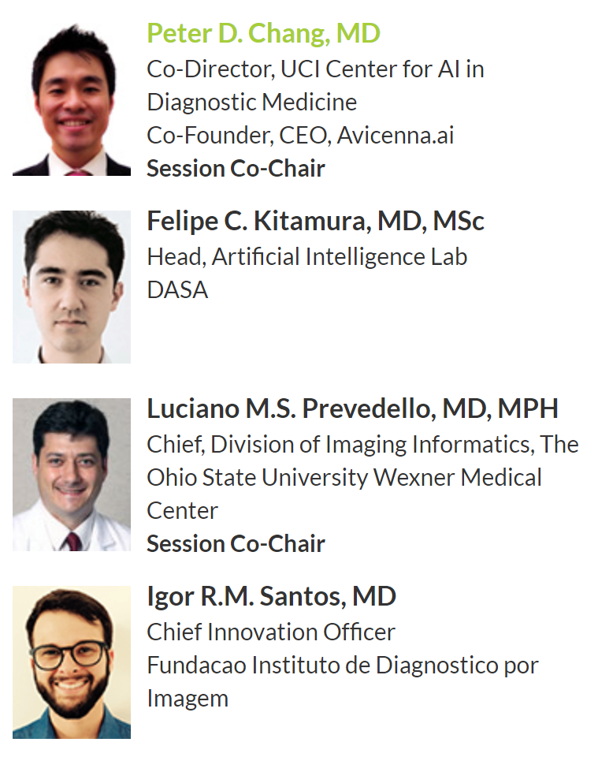
Faculty

Slide 3
Instructions
Connect to Wi-Fi (SIIM – password: #Empower)
Open Chrome
Access the link https://bit.ly/2KJHBYi

Slide 4
Experiment 1
Unbalanced dataset, no data augmentation
60 normal
6 hemorrhages
Total of 66 cases

Slide 5
Experiment 2
Balanced dataset, no data augmentation
33 normal
33 hemorrhages
Total of 66 cases

Slide 6
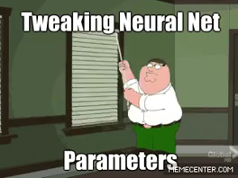

Slide 7
Experiment 3
Balanced dataset, transfer learning, no data augmentation
33 normal
33 hemorrhages
Total of 66 cases

Slide 8
Experiment 4
Balanced dataset, transfer learning, data augmentation
33 normal
33 hemorrhages
Total of 66 cases

Slide 9
Experiment 5
Balanced dataset, transfer learning, data augmentation
60 normal
60 hemorrhages
Total of 120 cases

